Slide 1
4.3 Ito's Integral for General Integrands
報告者：張議文
古豐上

Slide 2
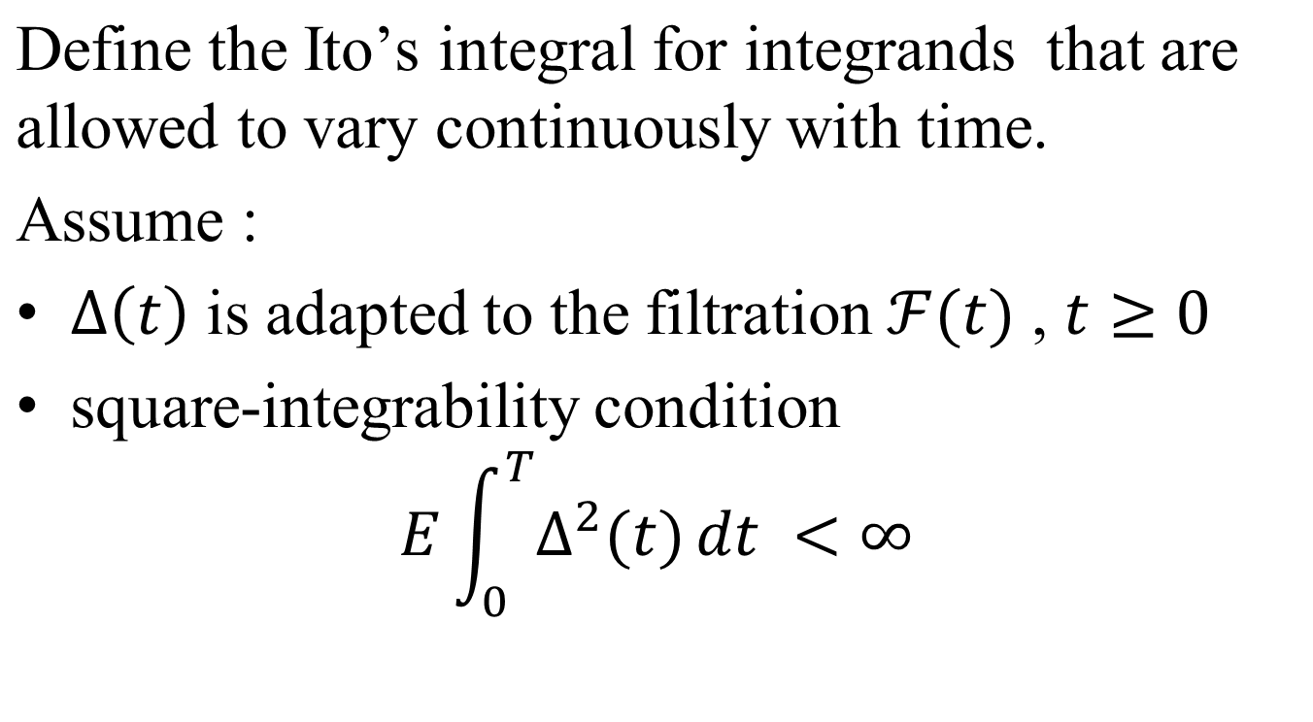
In order to make Ito isometry exist

Slide 3
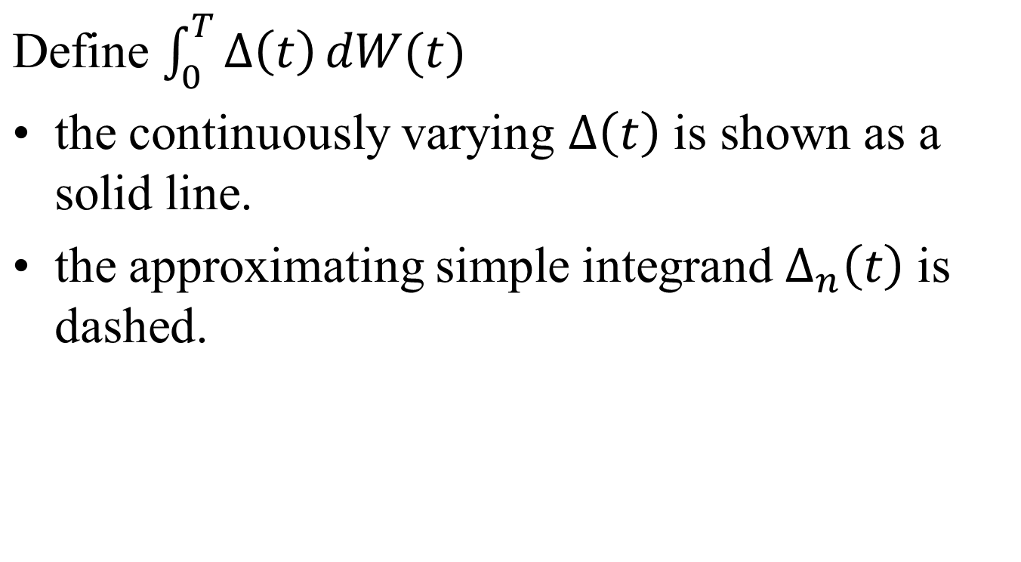

Slide 4
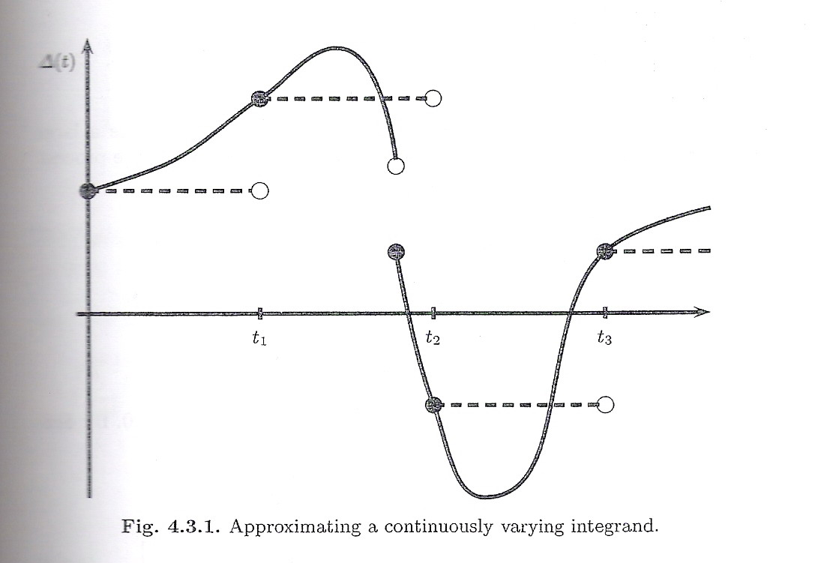

Slide 5
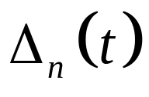

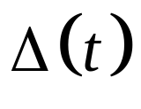
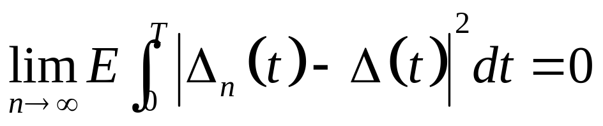
In general, it is possible to choose a sequence
of simple processes such that as these processes converge to the continuously varying .
By “converge”, we mean that

Slide 6
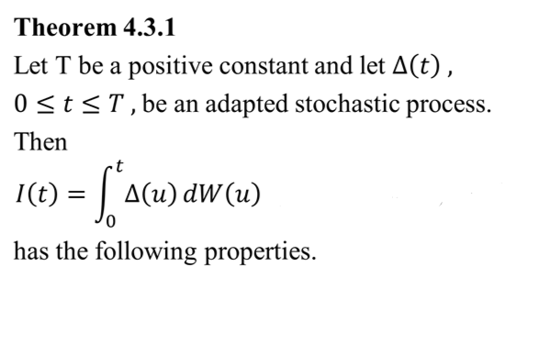

Slide 7
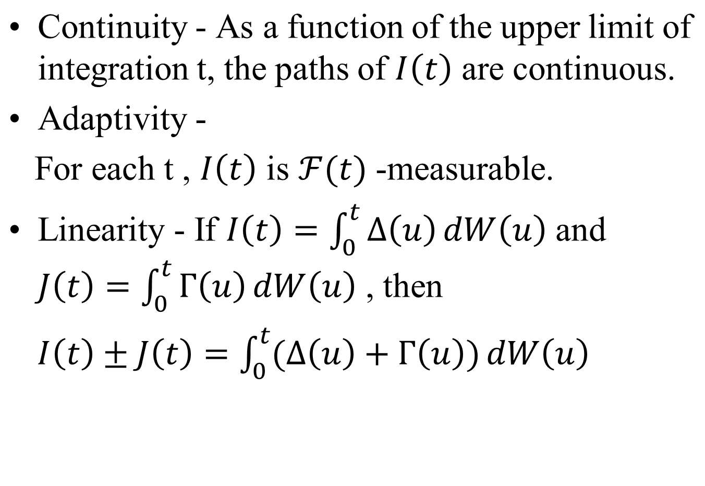

Slide 8
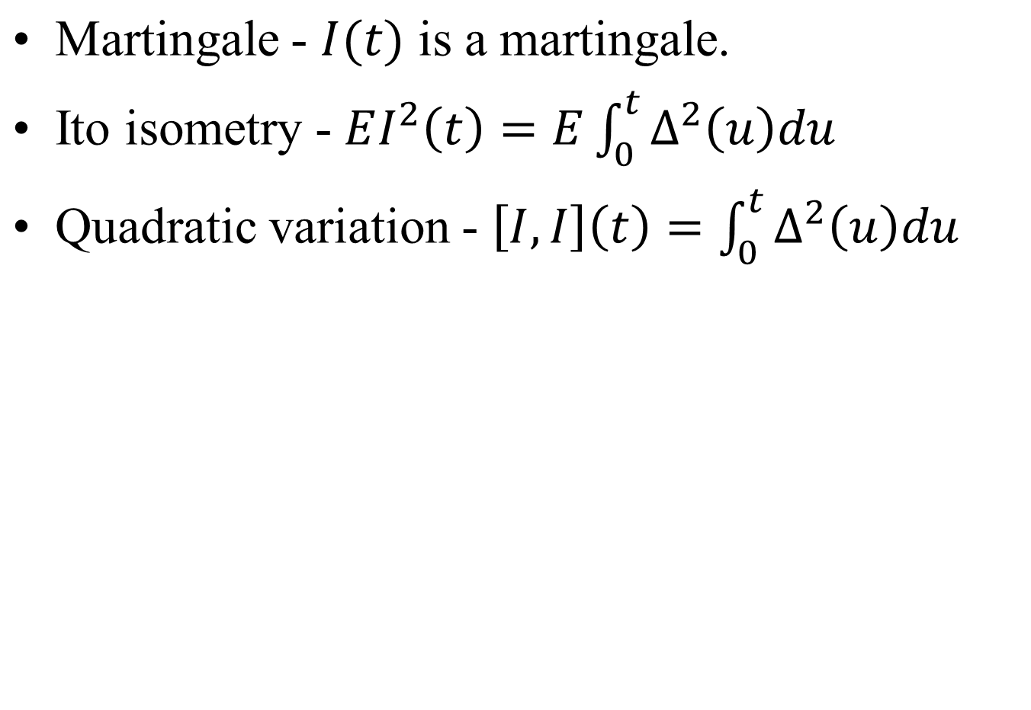

Slide 9

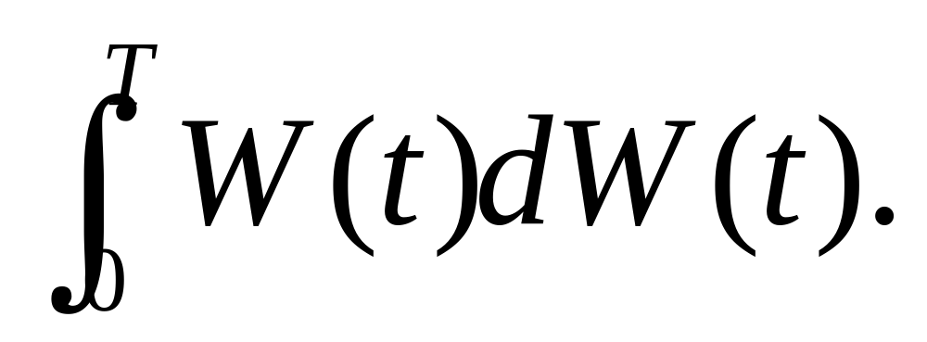
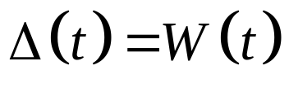
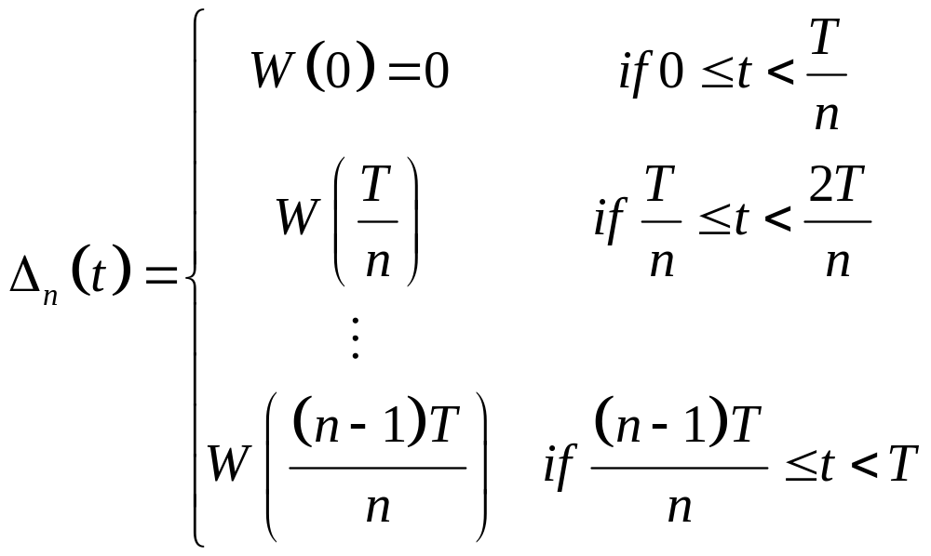
Example 4.3.2
Computing We choose a large integer n and approximate the integrand
by the simple process

Slide 11
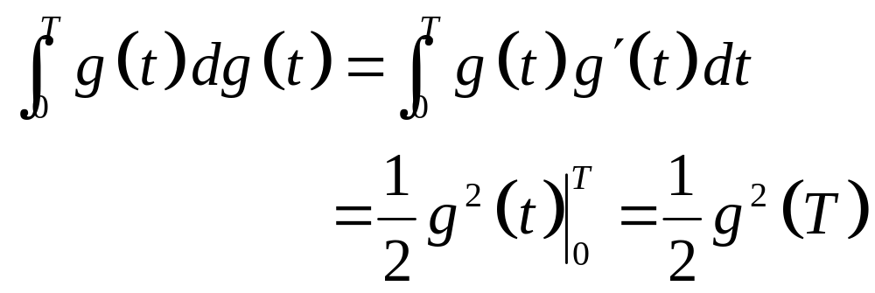
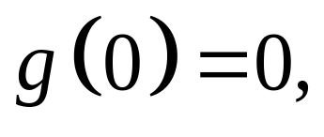
By ordinary calculus. If g is a differentiable function with then

Slide 12
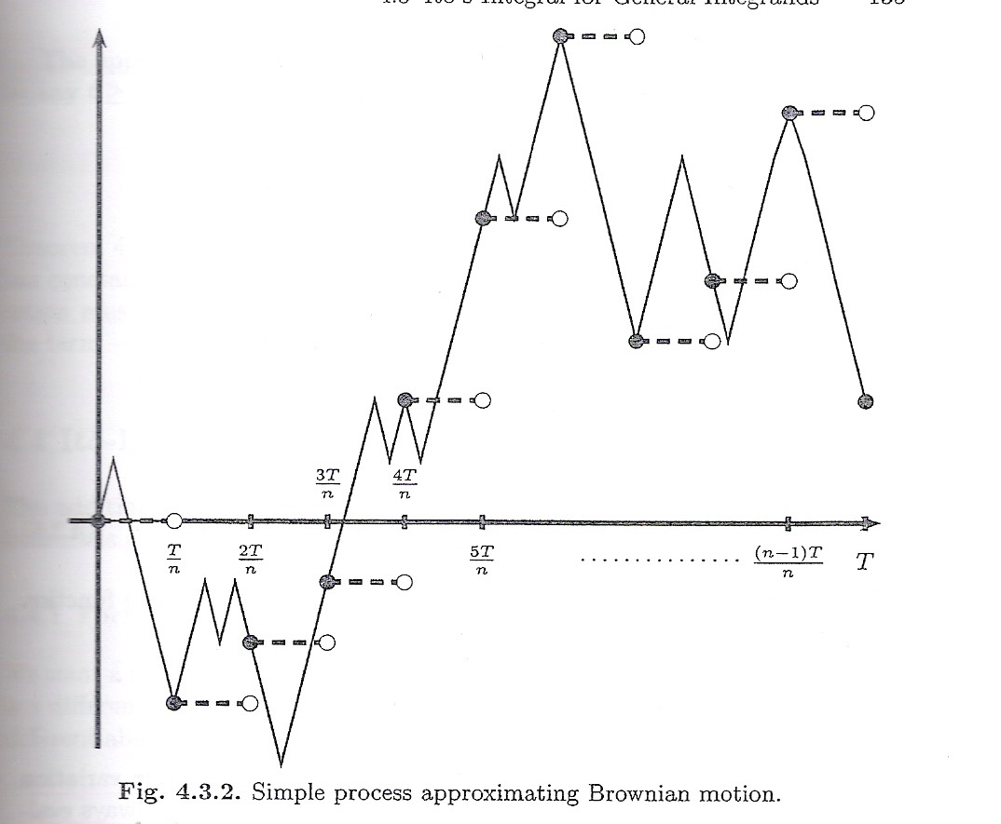

Slide 13
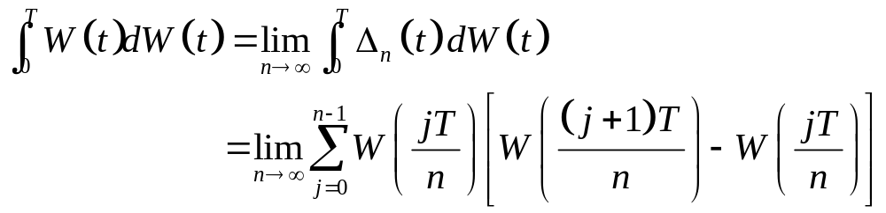
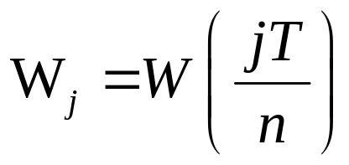
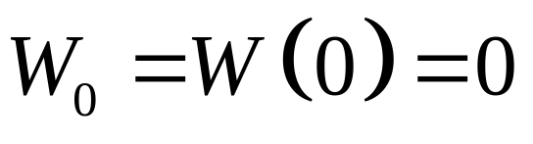
By definition
Lebesgue Integral → Riemann Integral
Let
and

Slide 14
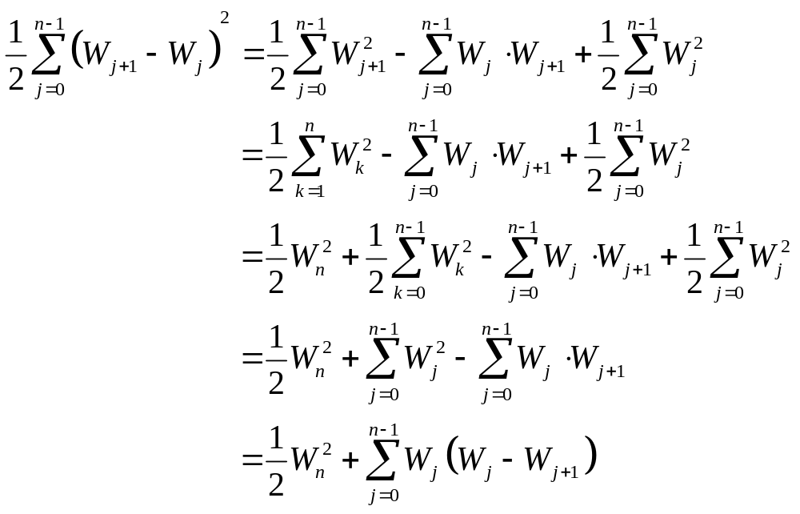




Slide 15
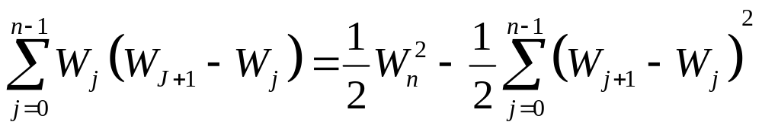

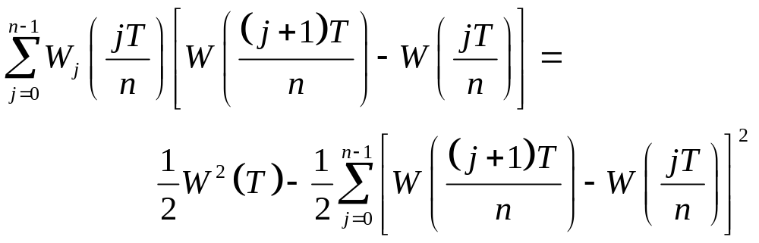
Conclude that
In the original notation

Slide 16

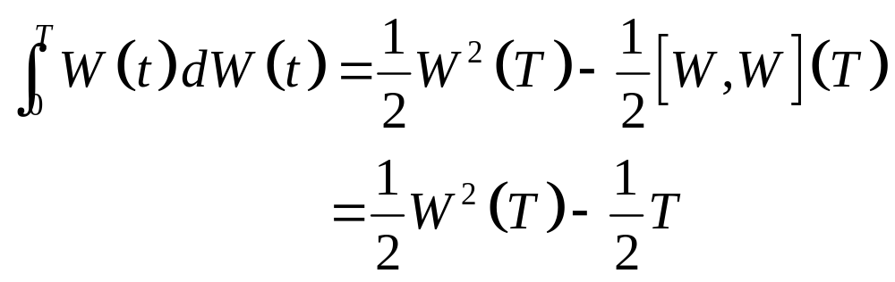
Letting ,

Slide 17
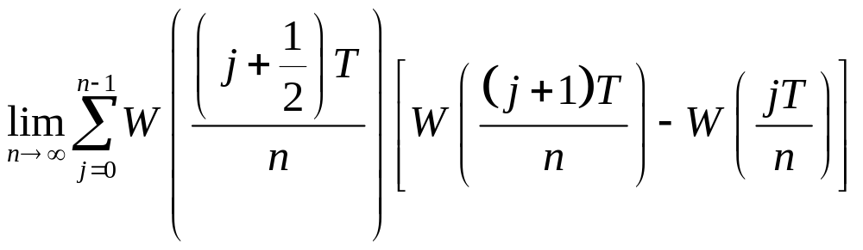
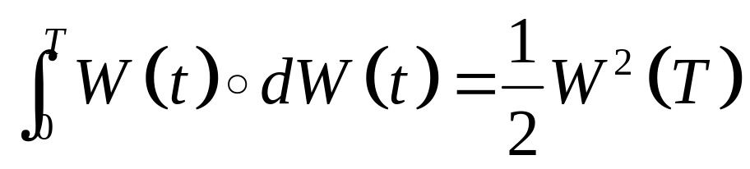
Usually, evaluating the integrand at the left-hand endpoint of the subinterval.
If evaluating the integrand at the midpoint,
then ( see Exercise 4.4 )

Slide 18

is called the Stratonovich integral.
Stratonovich integral is inappropriate for finance.
In finance, the integrand represents a position in an asset and the integrator represents the price of that asset.
The difference of the Stratonovich integral and the Ito integrand is sensitive. Stratonovich integral is less sensitive than Ito integrand.

Slide 19

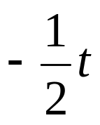
The upper limit of integrand T is arbitrary, then
By Theorem4.3.1
At t = 0, Stratonovich integral and Ito integral martingale are 0 and their expectation are 0.
At t > 0, if the term is not present and EW²(t) = t, Stratonovich integral does not follow martingale property.

Slide 20
The End

